Slide 1
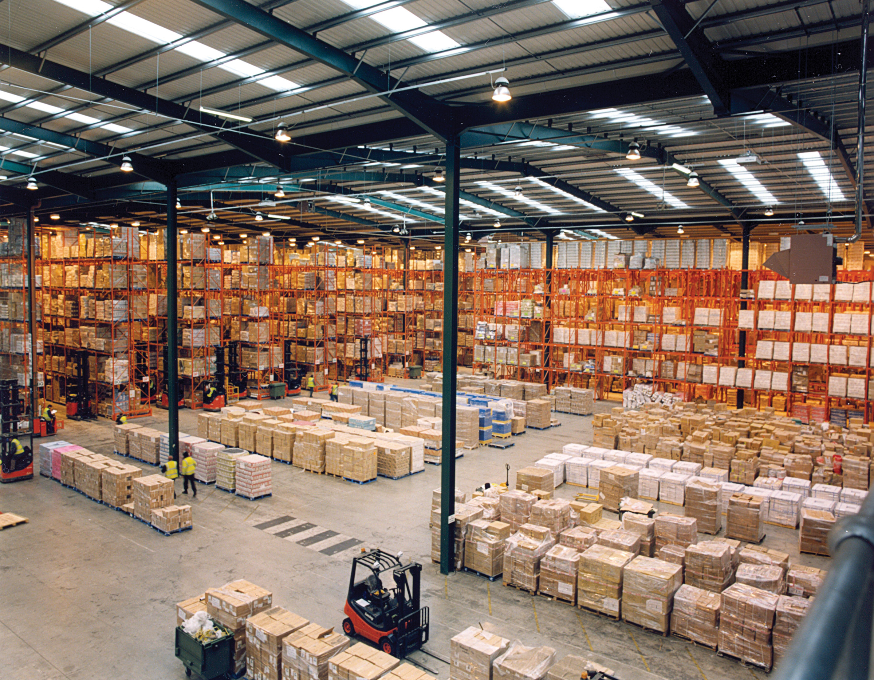
Warehouse Layout

Slide 2
Outline
Introduction – Problem
Mathematical Definition & Model
Solution

Slide 3
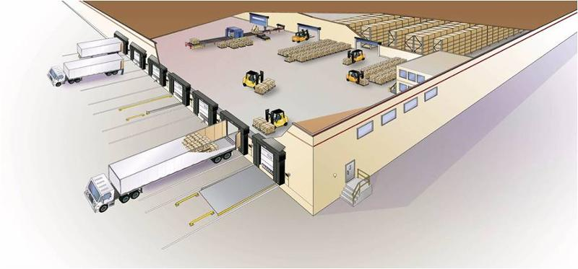
Introduction
A warehouse typically is configured with docks for loading and unloading goods and with open areas for storing the goods.

Slide 4
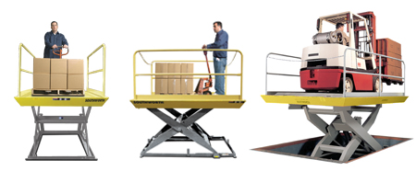
Introduction
The staff must decide where to locate each of the goods to minimize the cost of transporting items between docks and storage areas
(1) accessing the good and transferring it to the dock for loading
(2) unloading the good from dock and transferring it to the storage area

Slide 5
Introduction
The staff must decide where to locate each of the goods to minimize the cost of transporting items between docks and storage areas

Slide 6
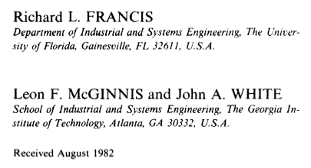
Related Problem
Paper
Locational analysis

Slide 7
Mathematical Definition
Assumption
The company using a warehouse to store p items.
The warehouse has r loading & unloading docks.
w_{ik} : a known total cost per foot incurred in transporting item i between dock k and storage
Objective
Minimize the cost
Cost : w_{ik}*d
i
Dock k
Storage region
d
d

Slide 8
Solution
First, discretize this problem by subdividing the floor area into q square grids of equal size. (number in 1 to q)
Ex: When q is 9
1 | 2 | 3
4 | 5 | 6
7 | 8 | 9

Slide 9

Solution
While q ⬆, correctness ⬆
But problem size also ⬆
While q ⬇, correctness ⬇
But problem size also ⬇
So, it’s trade-off!!

Slide 10
Solution
Let F_{i} be the total number of grids required to store item i. For simplicity,
Let d_{kj} be the distance between dock k and the center of gird j.
Transportation cost : w_{ik} * d_{kj}
Average cost for locating item i in grid j
表示item i 在單一grid j 下的平均成本

Slide 11
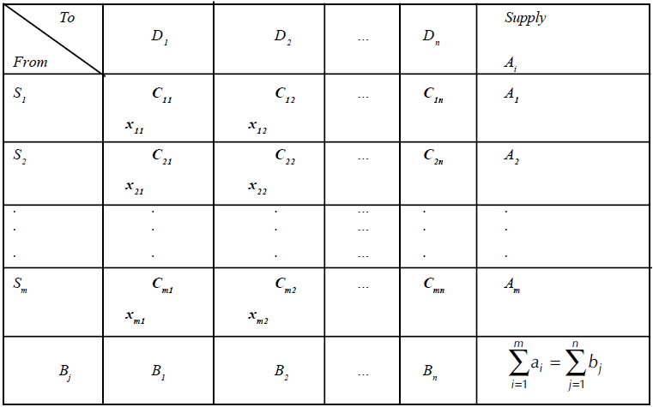

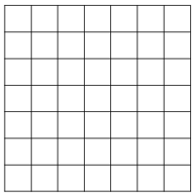
Because of…
Many grid -> what will you think of?

Slide 12
Solution
We can transform this question to Transportation Problem
Objective

Slide 13
Transformation Problem
j
Node i : item I
Node j : storage grid j
Each arc’s cost = c_{ij} * x_{ij}
Minimize the Transportation cost
Solution
Dual Simplex Method
Phase Two Method
Bounded Simplex Method
Big M Method.
i
1
1
2
2
3
3
4

Slide 14
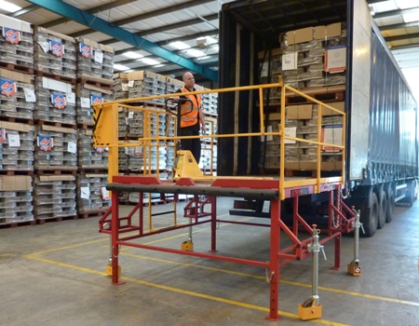
Thank you

